Slide 1
MySQL

Slide 2
MySQL
MySQL is a relational database management system. MySQL is a solution for small and medium DB applications. MySQL is typically used as a server accessed by local or remote clients.

Slide 3
Apache
Apache HTTP Server is a free, open source web server that can run on Unix and Windows operating systems. Apache is currently the most popular HTTP server on the internet.

Slide 4
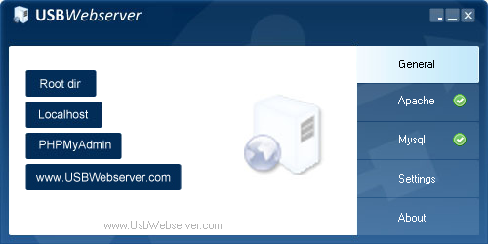
USBWebServer
A program that combines MySQL and Apache servers, allowing them to be started and configured quickly.
http://www.usbwebserver.net/webserver/

Slide 5
Web Server
Let's look at the process of creating a small DB (guestbook):
Creating a DB
Creating a Web interface for connecting to a DB server

Slide 6
Web Server
To be able to administer your database you need to execute an USBWebServer and open PHPMyAdmin. Enter username and password.

Slide 7
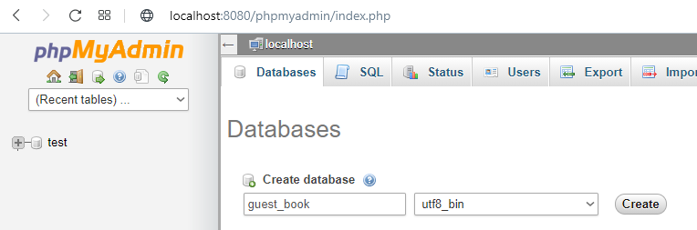
Web Server
In the Databases section create a new database – "guest_book". "Collation" should be changed to "utf8_bin".

Slide 8
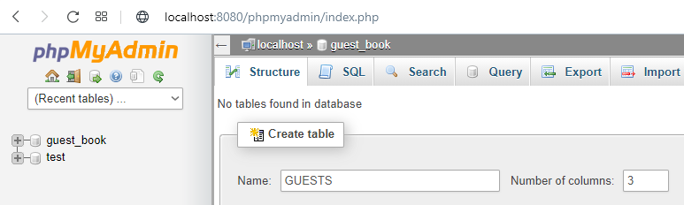
Web Server
Then you can create new tables in it. First, let's create a GUESTS table with three columns or fields.

Slide 9
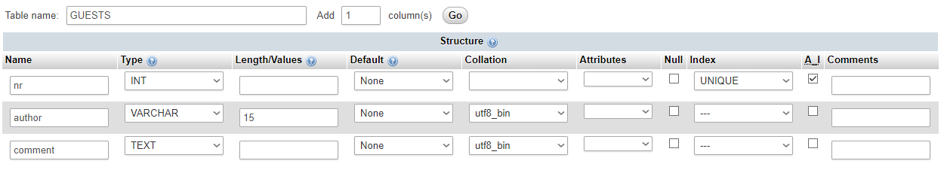
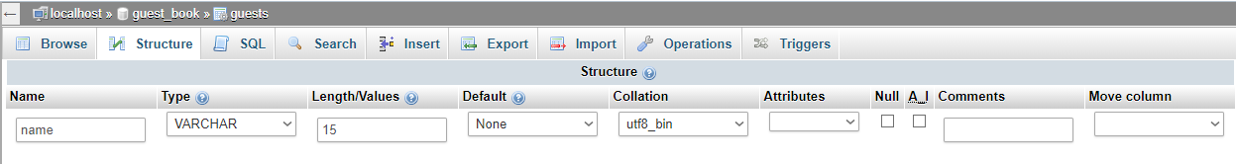
Web Server
You must define each field or column in the table by specifying the name and type of the field. One of the fields must be unique, or key field, so that you can unambiguously find everything in the table.

Slide 10
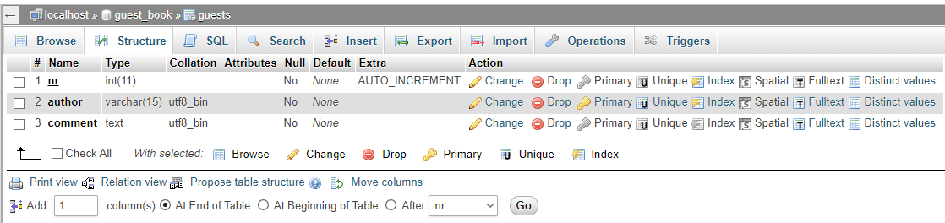
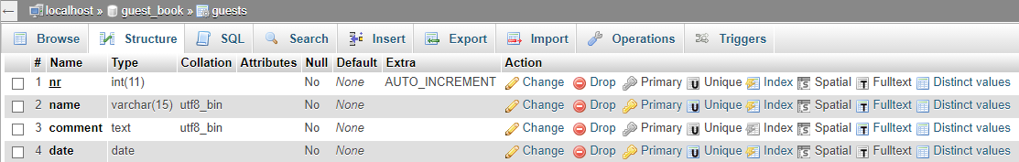
Web Server
If we think we need another field or column, we can add it. Let's add a date field of using date type after comment.

Slide 11
Web Server
As a result, the table should look like this:

Slide 12
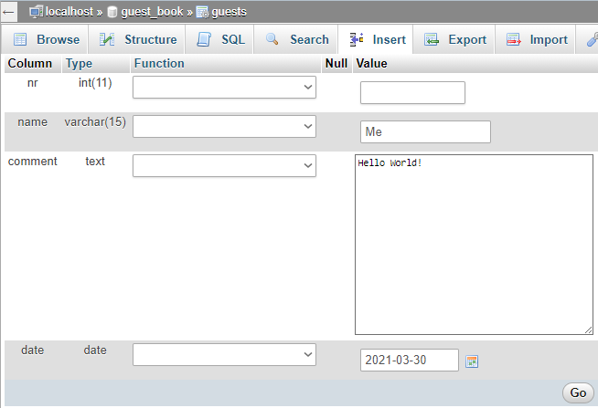
Web Server
Press Insert to add data to the newly created table. No need to enter nr, due to AutoIncrement DB will do it automatically.

Slide 13

Web Server
If we wish, we can also allow other people to enter data into this database. We will not tell them our password, but we will create a web form on the Internet through which the data can be entered and then sent to the database.

Slide 14
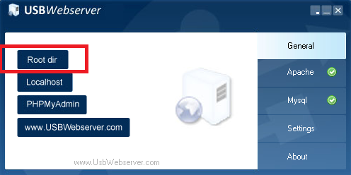
Web Server
Let's create a CommentForm.html document in the "Root dir" folder.
Create a form called guestForm, specify the method - POST and Action Url - toDB.php. There are two more text fields in the form called name and comment.
The code from toDB.php, will send data to the database, it must also be copied to the "Root dir" folder. You need to make changes to the program text - enter your database name, username and password.

Slide 15
Web Server
<html>
<head>
</head>
<body>
Welcome to my Guestbook!
<form method="post" action="toDB.php" name="guestform">
Name <input name=“name"><br>
Comment <input name="comment"><br>
<input name="submit" value="Add comment" type="submit"><br>
</form>
</body>
</html>

Slide 16
toDB.php
$_POST – connection to the form field
$_POST['name'] name – form field name
trim – deletes spaces from the beginning and end of a text string
strip_tags – deletes HTML and PHP tags from a text string
htmlentities – converts special symbols so that they can be stored in HTML code, such as
'&' to '&amp;'
'"' to '&quot;'
''' to '&#039;'
'<' to '&lt;'
'> to '&gt;'
mysql_connect function - Opens the connection with DB
mysql_select_db function - Selects a database

Slide 17
toDB.php
mysql_real_escape_string function - processes special symbols in a text string so that it can be used in a SQL-query. Such as: <?php $item = "Zak's and Derick's Laptop"; $escaped_item = mysql_real_escape_string($item); printf ("Escaped string: %s\n", $escaped_item); ?>
Will display Escaped string: Zak\'s and Derick\'s Laptop
mysql_query function sends a query to the database server
header("Location: CommentForm.html"); - go back to CommentForm.html

Slide 18
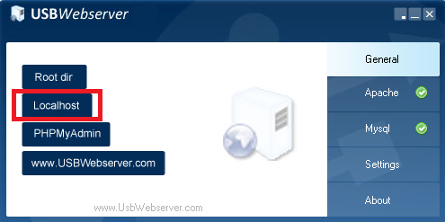
Web Server
When both files are ready and saved - open "Localhost"
and change the address to: http://localhost:8080/CommentForm.html.
Fill in the fields and send to the database. Then, open the phpMyAdmin, and check at the database – whether the data has reached the table.

Slide 19
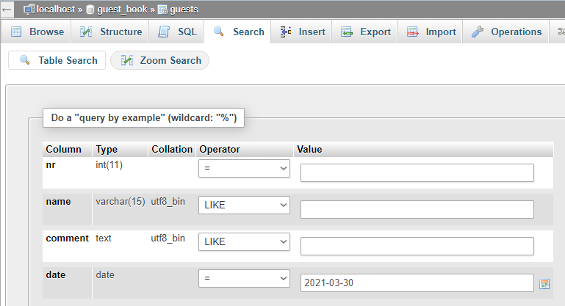
Web Server - Queries
Queries can be created using the Search view, for example, to search only those guestbook entries made on March 30, 2021.

Slide 20
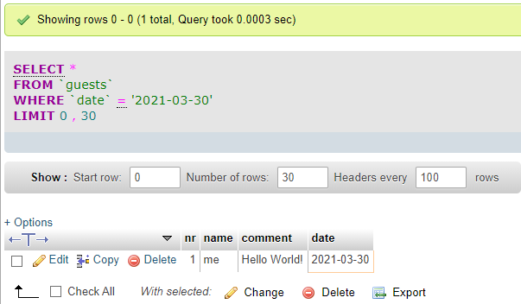
Web Server - Queries
You can then find in the SQL view that the actions you made have been converted into SQL language commands. SQL commands can also be written by hand, saved, edited, re-executed.

Slide 21
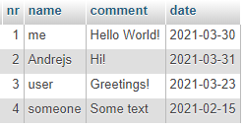
Web Server - Queries
If you have created a GUESTS table with the data shown in the picture, then we can request, for example, data about some specific author or some specific date.

Slide 22
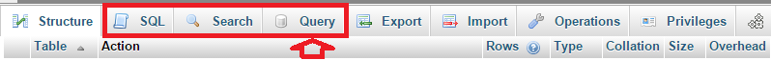
Web Server - Queries
In PhpMyAdmin, data queries can be made in SQL, Search, and Query sections.

Slide 23
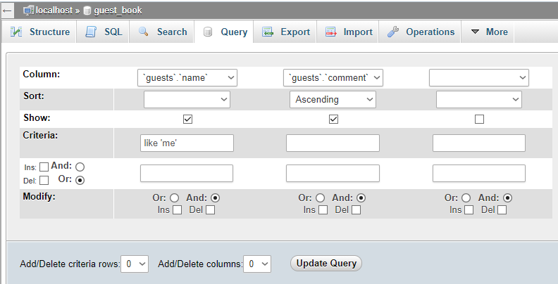
Web Server - Queries
Let's create a query based on a sample that selects all the author’s 'me' entries. By clicking Query, we select the data we want to see – name and comment.

Slide 24
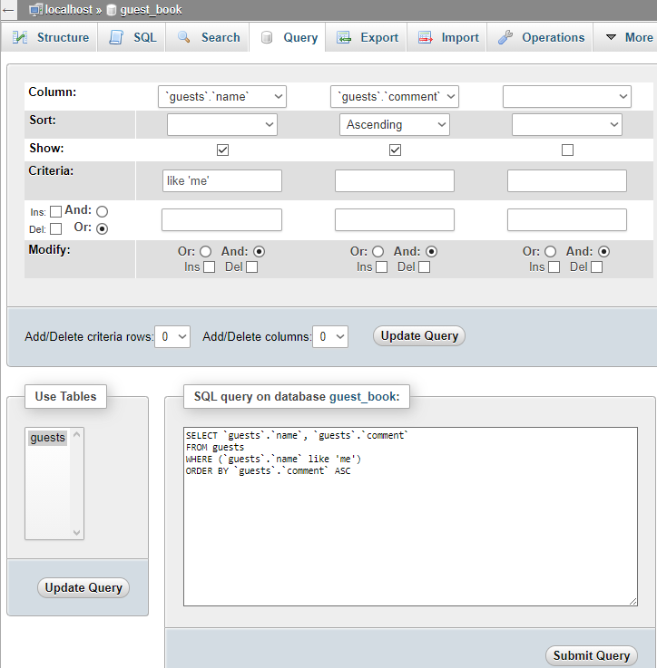

Web Server - Queries
When the required data is entered, click the "Update Query" button, which converts the query to SQL. When you press the Submit Query button, we will receive either a result or an error message. In case of error, press "Edit" and try to fix the query.

Slide 25
Practice
Add to the database table records for January, April, July and September 2020.
Create a query that displays only guestbook entries that are between April and July 2020.

Slide 26
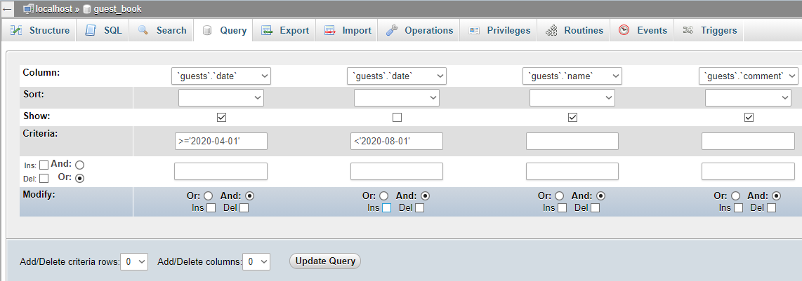
Practice
Answer:

Slide 27
Web Server - Queries
How do request data through a web page? You need to use some programming language, for instance php, that allows you to use sql constructions. An example is given in fromDB.php, which requests all data from the GUESTS table, but shows only two fields of data - name and comment.

Slide 28
Web Server - Queries
Copy file fromDB.php from a given folder to your web folder (root). Make the necessary changes to the copied file to connect to the database (username, password, database name)
Check the result at http://localhost:8080/fromDB.php. All records in the database should be visible.

Slide 29
Web Server – Queries - Practice
Change the fromDB.php file by replacing the existing sql query with the query that selects “me” author records.
Check the result at http://localhost:8080/fromDB.php. Should be visible only database records that have the author name "me" .
Modify the fromDB.php file to display also a date field. Check the result at http://localhost:8080/fromDB.php

Slide 30
Web Server - Queries
It would be good not to have to edit the program code to be able to change the query parameter.
Therefore, let’s change the fromDB.php file so that instead of the specific requested data there is a reference to the variable.
At place where we ask for WHERE ‘name’ like ‘me’, we will put WHERE ‘name’ like ‘$who’, but the value of the $who will be obtained by sending data from the web form.

Slide 31
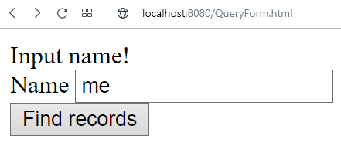
Web Server - Queries
In your web folder (root) get a copy of fromDB.php file, rename it to fromDBfromForm.php.
In the fromDBfromForm.php file replace WHERE 'name' like 'me' with WHERE 'name' like '$who'.
Using a sample from the toDB.php file, add necessary code to the fromDBfromForm.php file, and using the POST method, request data from the DB using the input field 'who’ value.
Create the form shown in the example. Set the Action URL of the form parameter to fromDBfromForm.php, and the input field name to 'what'. Save the result to a web folder (root) using QueryForm.html name.
Check the result at http://localhost:8080/QueryForm.html

Slide 32
Practice
Copy your file fromDBfromForm.php, rename it to fromDBdate.php and modify it to get the records between 2 dates. Start and end dates would be assigned as variables $from and $to. Create a form with two input fields from and to, the start and end date entries. Attach to the form fromDBdate.php file.

Slide 33
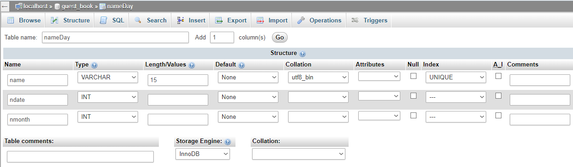
Data import
Create a new table nameDay with 3 fields (name, ndate, nmonth) in your database. Set the name field by the unique key field.

Slide 34
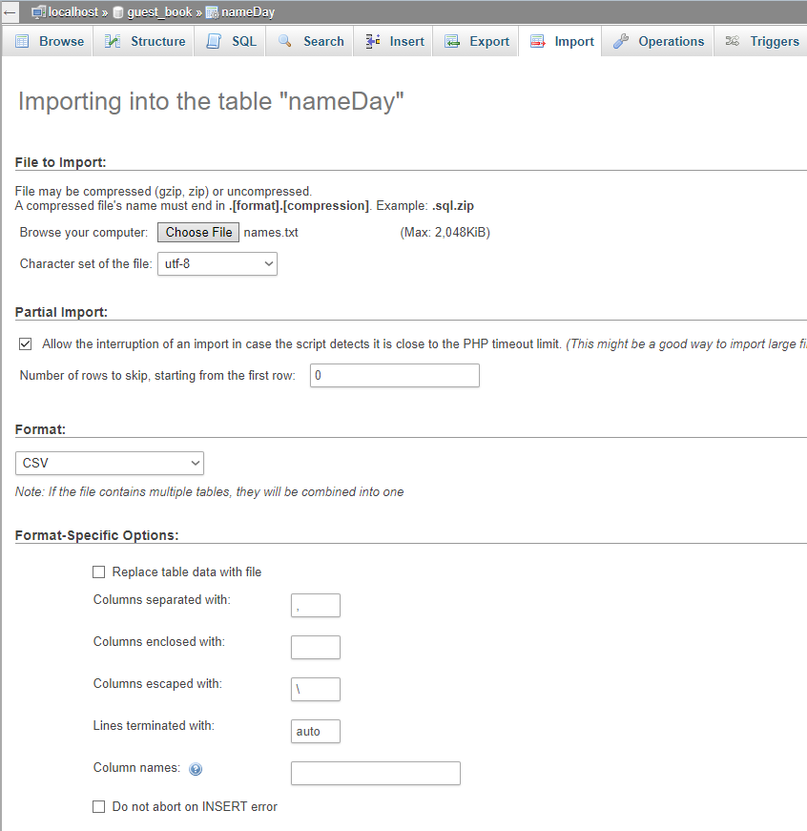
Data import
Import data from the names.txt file located in the MySQL folder.
In the import window, choose the correct data Format (CSV), data field separator (comma), delete anything from Columns enclosed with field and set Columns escaped with field to \.
If the import completes successfully, you will see a message about 5095 added rows.

Slide 35
Practice
Search the nameDay table to find out when name day is celebrated by Aiva. Create a query that selects all names ending with ‘a’ (LIKE '%a' criterion). Create a query that selects all women's names – names with endings ‘a’ or ‘e’. Create a query that finds all women's names who have name day in March.

Slide 36
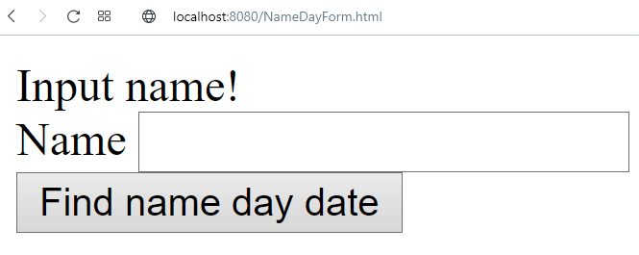
Practice
Create a form that allows you to request someone’s name day date through the Web:

Slide 37
Practice
Make a copy from fromDBfromForm.php file, rename it to fromDBname.php
Make changes in fromDBname.php file, to request data from nameday table:
Change sql query code $sql="SELECT `nameday`.`name`, etc.
Izmainīt rezultātu tabulu
<td>".$result[$i][‘name']."</td> <td>".$result[$i][‘ndate']."</td> <td>".$result[$i][‘nmonth']."</td>
Create a form in NameDayForm.html file, set Action URL to fromDBname.php.
Check the result at http://localhost:8080/fromDB.php, find when Aiva celebrates name day.

